Slide 1
ADMISSION ANALYTICS & REPORTING

Slide 2
INSTITUTE
InstituteID (pk)
InstituteName
Location
Type
AffilatedUniversity
EstablishedYear
FACULTY
InstituteID (fk)
FacultyID (pk)
DeanName
OfficeLocation
FacultyName
Email
FacultyCode
DEGREE
DegreeID (pk)
FacultyID (fk)
ProgramName
Level(ug,pg)
Duration
creditreqirment
PROGRAM
ProgramID (pk)
DegreeID (fk)
ProgramName
Specialization
IntaleCapacity
AccreditationStatus
Duration

Slide 3
PROGRAM FEES
FeeID (pk)
ProgramID (fk)
FeeAmount
APPLICANT
ApplicantID (pk)
FullName
Gender
FatherName
MotherName
Emargencycontact
Photo(url)
Categary
ProgramID (fk)
D.O.B
ADMISSION TEST
TestID (pk)
TestType
ProgramID (fk)
Maxmarks
MinQualifyMarks
TestDate
TEST FEE PAYMENT
TestPaymentID (pk)
ApplicantID (fk)
TransactionID
PaymentStatus
ReceiptURL
TestID (fk)

Slide 4
APPLICATION *
ApplicationID (pk)
ApplicantID (fk)
ProgramID (fk)
Applicationdate
Status (varified or not)
FacultyID (fk)
LOGIN
LoginID (pk)
UserName
Password
Role (student/admin)
TEST COMPLATION STATUS
StatusID (pk)
ApplicantID (fk)
TestID (fk)
ScoreObtained
Result (pass/fail)
Rank
ACADEMIC DETAILS
RegistrationID (pk)
ApplicationID (fk)
Qualification
BoardOrUniversity
GradeSystem(cgpa/percentage)
Percentage (CGPA)
PassingYear

Slide 5
APPLICATION FEE PAYMENT
TransactionID (pk)
ApplicationID (fk)
AmountPaid
PaymentMode
PaymentStatus(successful or failed)
Receipt URL
MASTER DOCUMENTS
MdocumentID (pk)
ApplicantID (fk)
AadharCard
10th_Marksheet
10th_Certificate(if applicable)
12th_Marksheet
12th_Certificate(if applicable)
Migration_certificate
Caste_certificate
Domicile_certificate(if applicable)
Test_result
Character_certificate
FROM COMPLETION STATUS
CompletionID (pk)
ApplicationID (fk)
Status
Application from(url)
Receipt(url)
COUPONS
CouponCode (pk)
DiscountPercent
IsActive
ExpiryDate
CouponID (uk)
CategoryEligibility
ApplicantID (fk)
DOCUMENTS
DocumentID (pk)
ApplicantID (fk)
DocumentType
FilePath(FileServer)
UploadDate

Slide 6
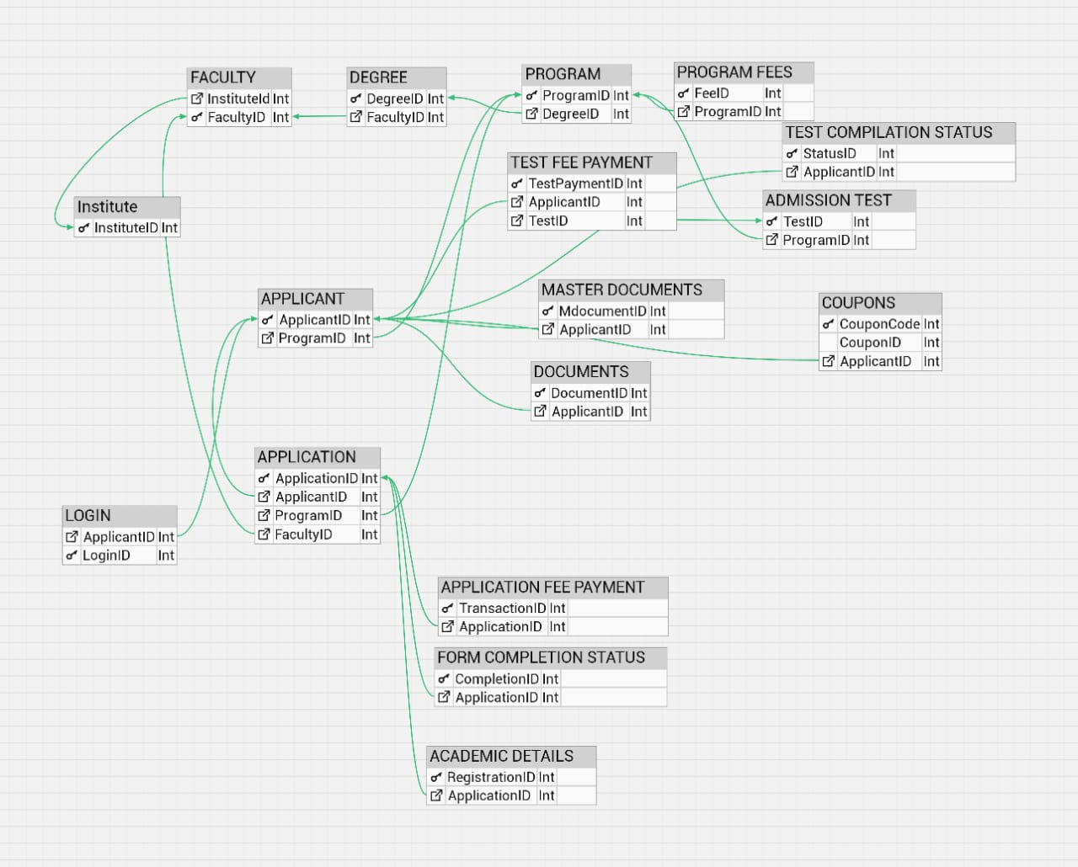

Slide 7
Parent Entity | Child Entity | Relationship | Description
Institute | Faculty | 1 to Many | One institute can Have Many faculties
Faculty | Degree | 1 to many | One faculty offers multiple degrees
Degree | Program | 1 to many | A degree can have multiple Programs
Program | Admission test | 1 to many | A program can have multiple admission tests
Program | Application | 1 to many | A program can receive many applications
Program | Applicant | 1 to many | One program can have many admitted applicants
Applicant | Application | 1 to 1 | One applicant can apply to one Application
Application | Acadmic Details | 1 to many | One application can have multiple academic qualifications.
Application | Application fee payment | 1 to 1 | One application may have one payments
Admission test | Test fee payment | 1 to many | One test fee can be paid by many applicants

Slide 8
Parent Entity | Child Entity | Relationship | Description
Admission test | Test Completion | 1 to many | One test will have completion records from many applicants
Applicant | Test completion | 1 to 1 | One Applicant can appear for only one test at a time
Applicant | Test fee payment | 1 to 1 | One applicant will pay one test fee payment
Applicant | Documents | 1 to many | One Applicant can have many Documents
Applicant | Coupons | 1 to 1 | One Applicant can have only one coupon

